Slide 1
ETSI 004
Madrid Example

Slide 2
How is it set up
TCP Socket
Alice
Encrypted messages
Bob
encrypt(), decrypt(), get_key(), get_key_bytes()
encrypt(), decrypt(), get_key(), get_key_bytes()
Application class
Application class
open_connect(), get_key(), close()
open_connect(), get_key(), close()
Application driver
Application driver
TCP Socket
TCP Socket
LKMS node 1
LKMS node 2
Bitstream
Bitstream
Random number generator
Random number generator
Same seed !

Slide 3
How does it work

Slide 4

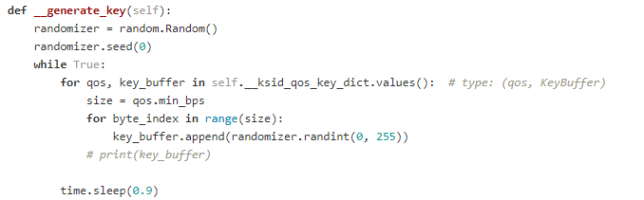
Random number generator
Periodically add a key to the buffer (every 0.9 seconds)
Same seed -> same key

Slide 5
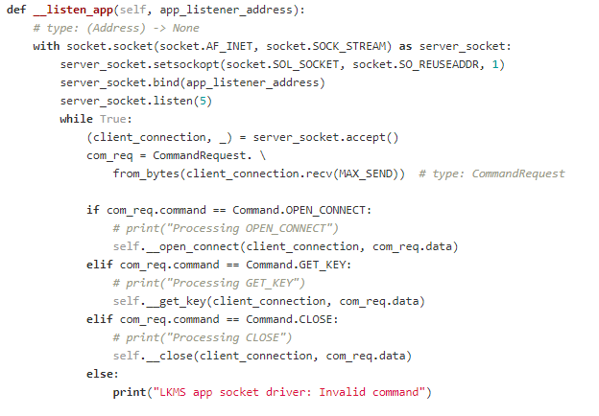
LKMS
Spawns thread with socket listener
Answers API calls
Also spawns thread with key generator
The keys are stored in the LKMS class (not accessible anywhere else)

Slide 6
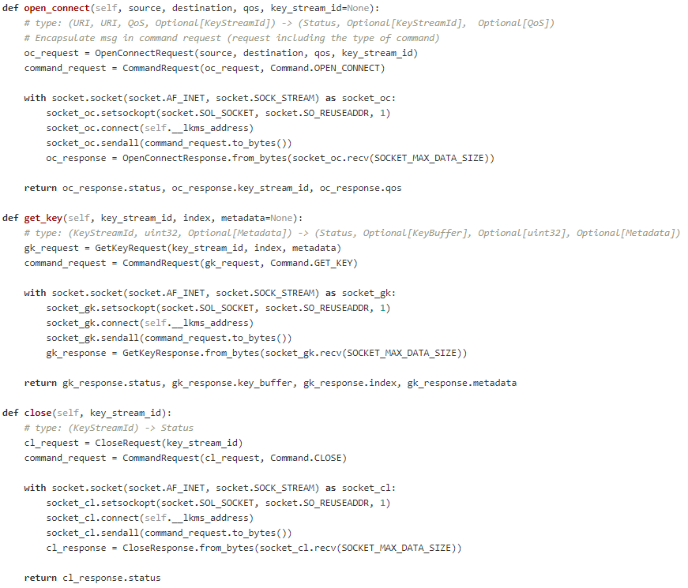
Application driver
Translates the API calls with python variables to a TCP packet

Slide 7
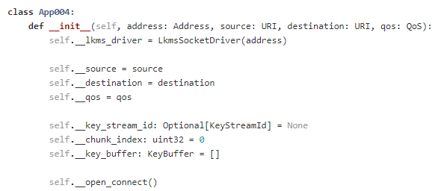
Application class
Abstracts the programmer from the API calls
Allows the programmer to directly encrypt/decrypt his messages or get the key bytes

Slide 8
Implementing raw keys
We can implement raw keys by having an input parameter on the LKMS Simulator corresponding to the error_chance
The key and error_chance is passed by the LKMS to the App

Slide 9
How is it set up
TCP Socket
Alice
Encrypted messages
Bob
encrypt(), decrypt(), get_key(), get_key_bytes()
encrypt(), decrypt(), get_key(), get_key_bytes()
Application class
Application class
open_connect(), get_key(), close()
open_connect(), get_key(), close()
Application driver
Application driver
TCP Socket
TCP Socket
LKMS node 1
LKMS node 2
Bitstream
Bitstream
Random number generator
Random number generator

Slide 10
Alice
GET_KEY(size)
raw_key, error_chance
Key Manager
error_chance
raw_key
Random Number Generator

Slide 11
Examples

Slide 12
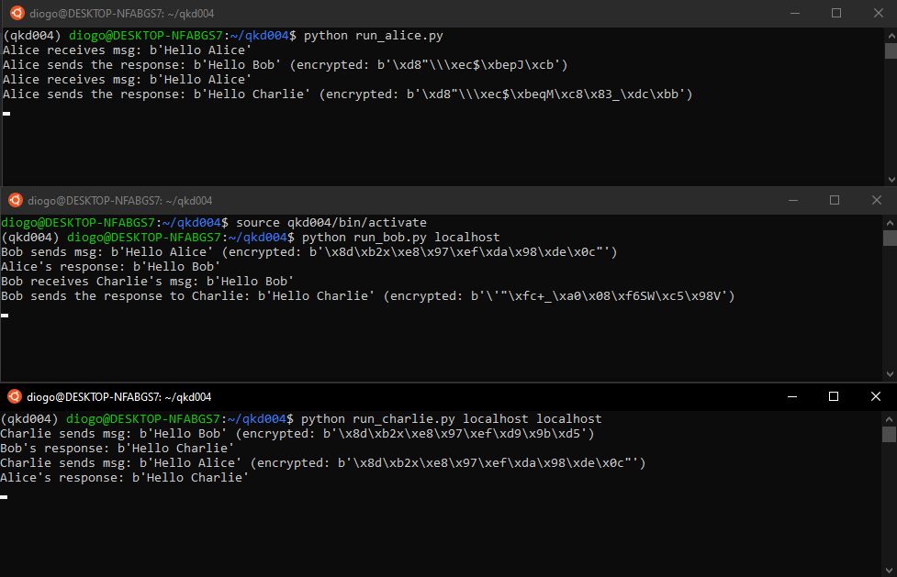

Slide 13
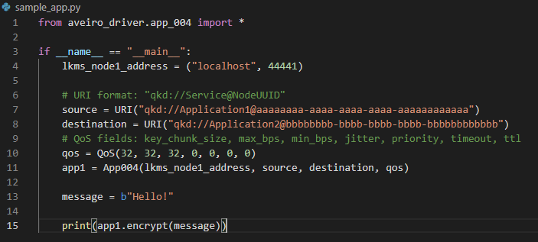
Encrypting a message

Slide 14
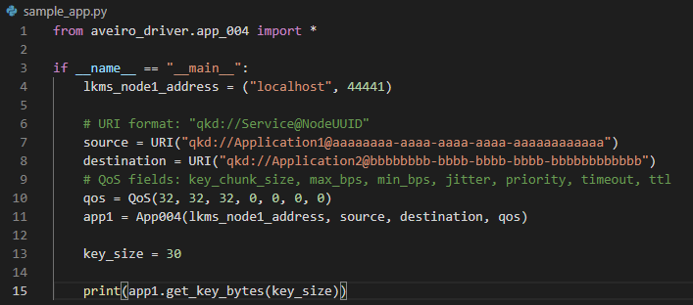
Getting keys

